Slide 1

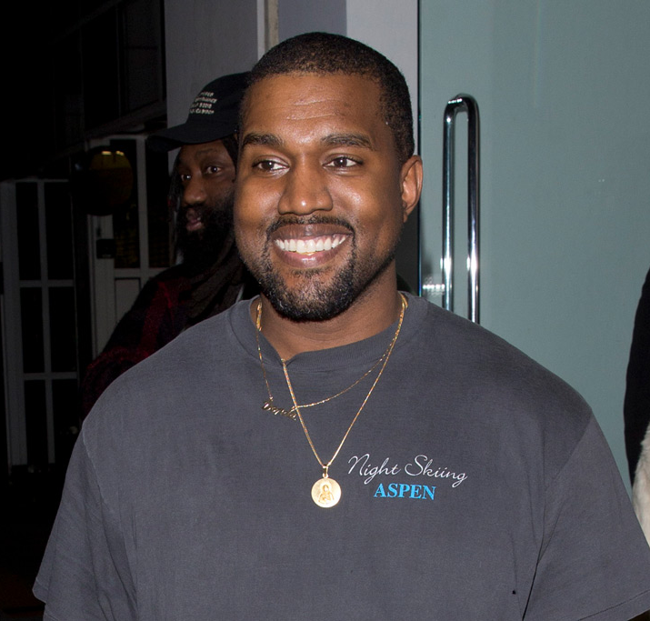
HUNGRY HUNGRY YE
A GAME BY MICHAL&SCOTT STUDIOS

Slide 2
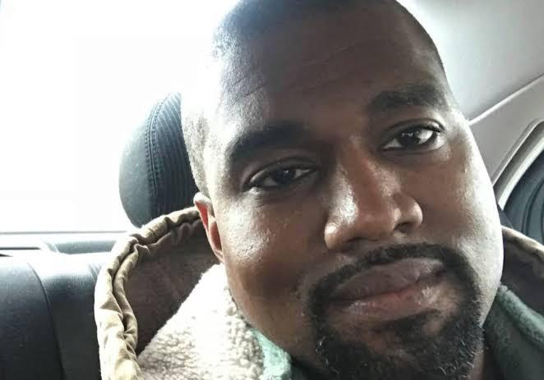
ELEVATOR PITCH
A catch type game set in the glamorous city of Paris
Hungry Kanye collecting food falling from the top of the Eiffel Tower
Feast as much as possible, testing your reaction speed and awareness to the highest degree

Slide 3
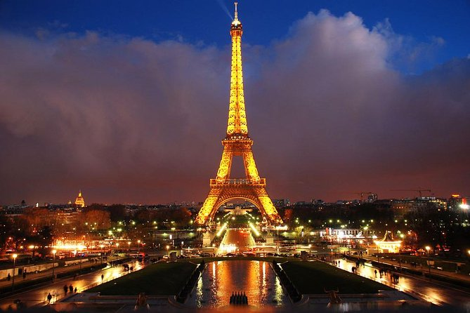
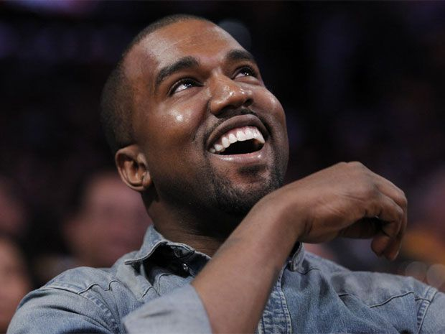
GAMEPLAY
DESCRIPTION
Collect all sorts of Kanye’s favourite foods – from Croissants to McDonald’s
Avoid other things dropping from the Eiffel Tower above.
Background music – medleys based off of Kanye’s discography

Slide 4
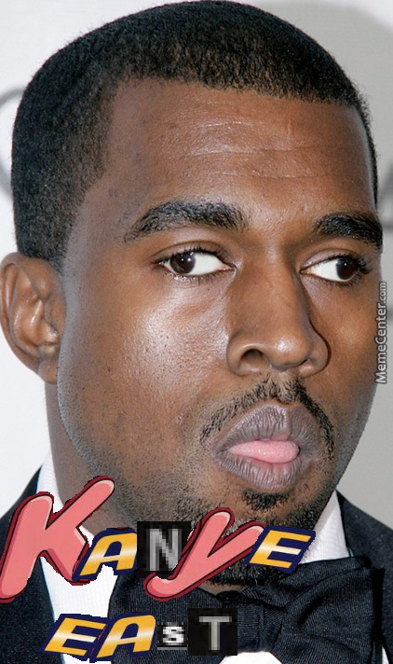
PILLARS
Every time catch ten items the rate at which they drop increases by .0000005.
Must avoid Drakes CLB album covers or be reset to 0.
Catch the ¥ to earn 2 points.
Beat the max score of 1,000,000 and win a free pair of yeezys.

Slide 5
FEATURES
Real Kanye West including face and Voice Acting.
Features the hit song Homies in Paris.
Unlock new characters by earning in game currency from playing.
Unlockable characters include,
Travis Scott and Kim Kardashain.

